Slide 1


Slide 2
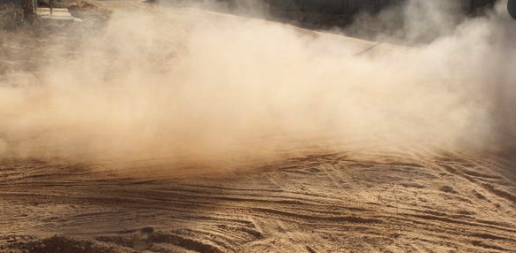


New! Dust Suppressor
Transmission Line Works:
  Opening of accesses;
  Excavation;
  Cable Laying;
  High traffic of machines and vehicles;
  Prohibition of Services in Weather with Many Rain Clouds (Dry)
Lots of dust

Slide 3
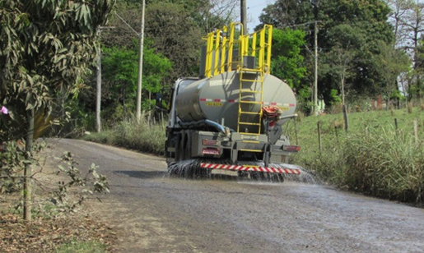
New! Dust Suppressor
Conventional Solutions:
  Spray Water on Paths:
    High Fuel Consumption;
    Water consumption (often drinking water);
      Water rationing period in many countries;
    Low efficiency in tropical regions, rapid evaporation
Very expensive, short-lived results

Slide 4

New! Dust Suppressor
New! TEXPI Dust Suppressor:
  Multifunctional Biodegradable Polymer:
    Environmentally friendly;
    No toxicity;
    No pollution;
    No skin irritation;
    No irritation to the respiratory tract
Eco-Friendly

Slide 5
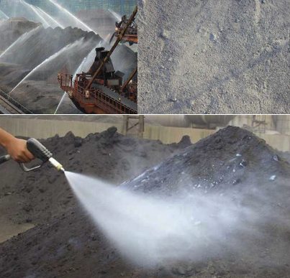

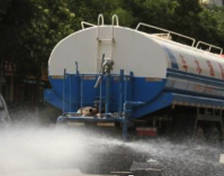
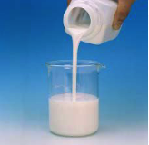
New! Dust Suppressor
New! TEXPI Dust Suppressor:
  Easy Application:
    The same traditional system (spraying) is used;
    Dilute the polymer in water;
    Proportion of 30 to 60 parts of water per 1 of polymer;
    Spraying, on a dry day, from 1.5 to 20 kg / m ²
      (dependent on average dust particle size)
    Spraying on dry soil/ore for at least 24 hours
      (ensure penetration of the mixture)
Simplicity

Slide 6
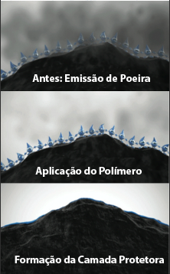
New! Dust Suppressor
New! TEXPI Dust Suppressor:
  Durability:
    Layer thickness after drying from 2 to 30mm;
    Layer hardness up to 3MPa;
    The strong and flexible layer;
    Durability of up to 3 months;
Before: Dust production
Polymer Application
Durability
Protection Layer Formed

Slide 7

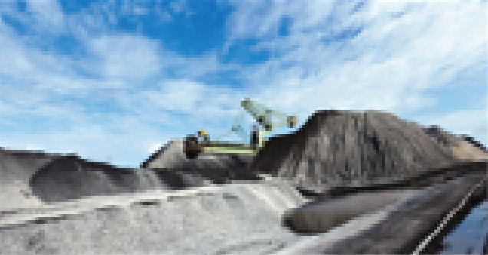
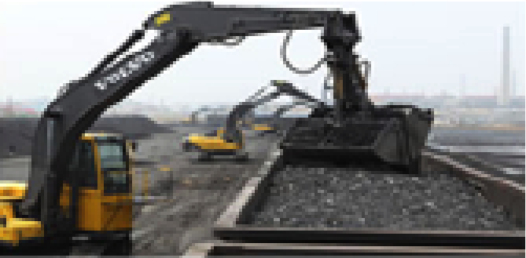
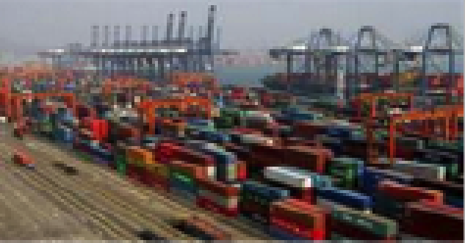
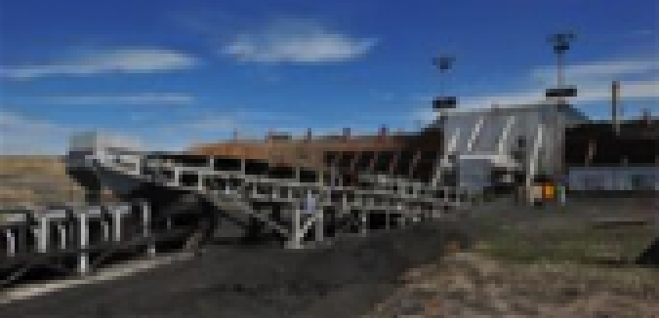
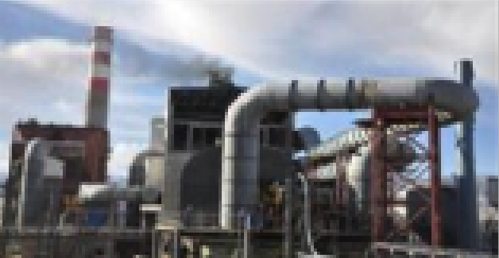
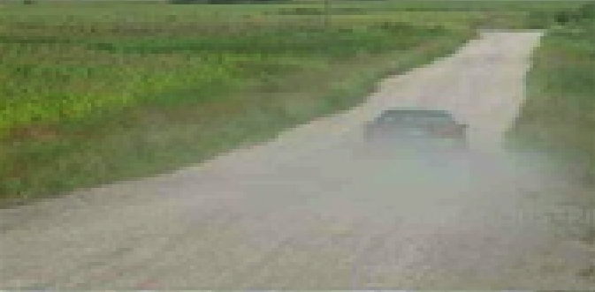
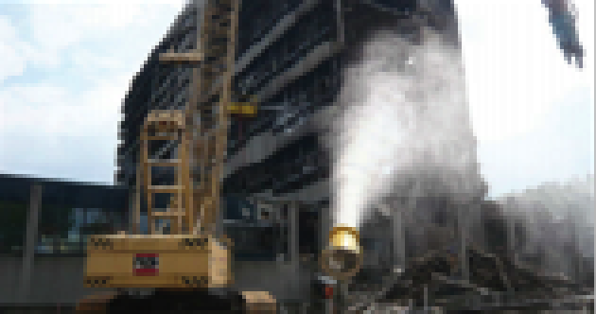
New! Dust Suppressor
New! TEXPI Dust Suppressor:
  Various Applications:
    Thermal Generation;
    Mineral Storage;
    Mineral Transportation;
    Iron and Steel Industry;
    Urban and Rural Dust;
    Construction Industry;
    Around Substations and Transmission Lines where dust from the ground raised by the wind contaminates the insulators

Slide 8
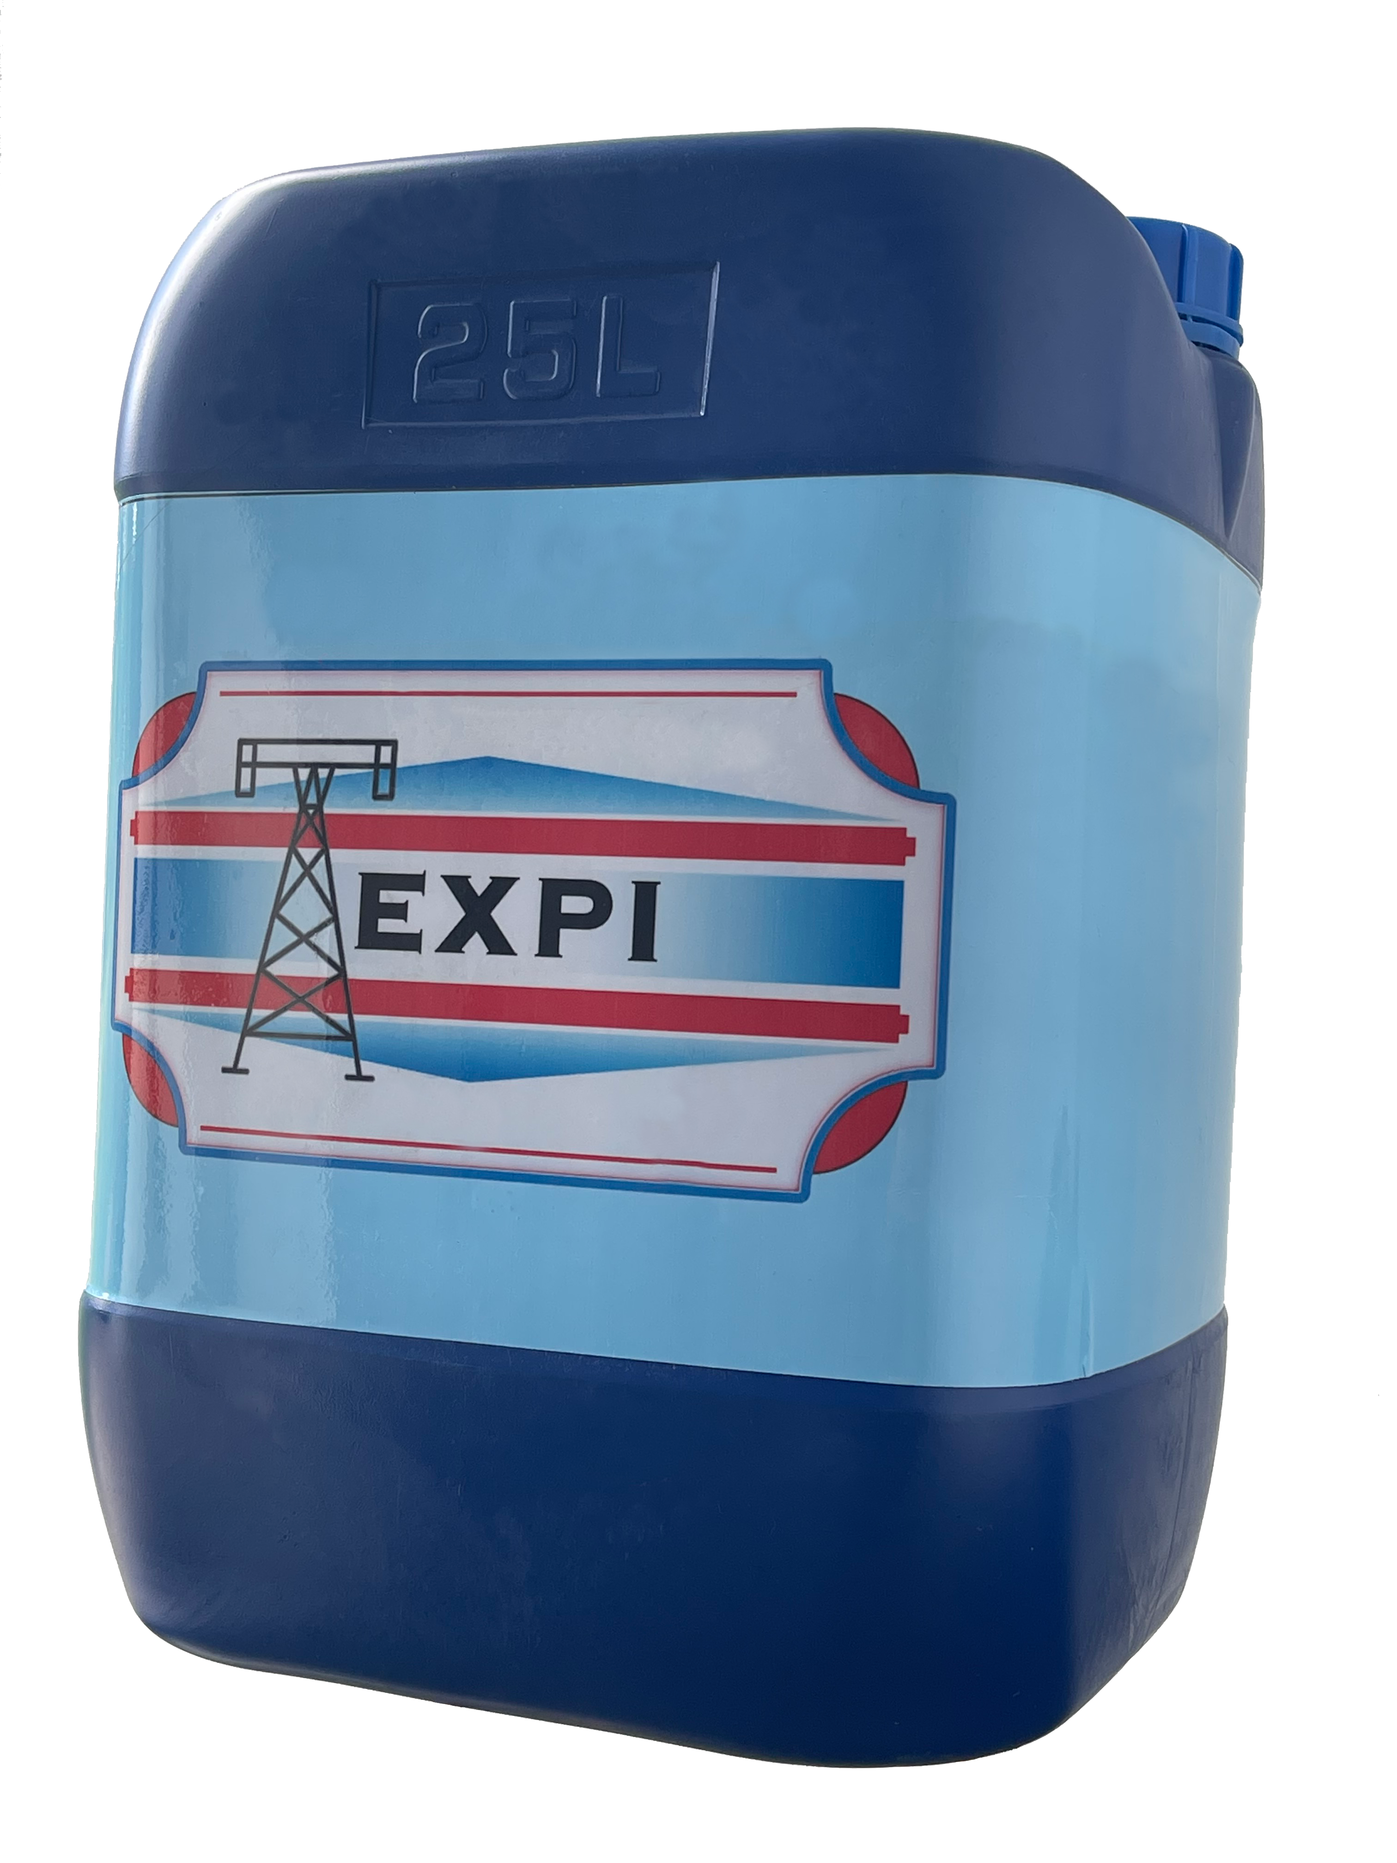
New! Dust Suppressor
New! TEXPI Dust Suppressor:
  Packaging:
    25kg drum ;
    Other options as needed.
  Storage:
    In a covered environment;
    Away from sources of heat and flame.

Slide 9
Questions and Answers
A: After applying the material to the mining roads, is it possible to use heavy vehicles in general, especially large trucks? Or is there a waiting period for it to dry completely?
It is recommended to spray a high concentration of dust suppressant on the dry mining road with a ratio of 1:10 to 1:20 to maximize the dust suppression capacity and adhesion to the mineral soil.
After 24 hours of spraying, the vehicle can be driven directly.
The adhesion of the dust suppression agent is consumed after some time, usually between 1 and 3 months.

Slide 10
Questions and Answers
B : Won't vehicle traffic cause the applied material to easily come off or stick to the tires?
The dust suppression agent, once dry, will not adhere to the tire.
The vehicle will travel along mining roads over soil with crusts and blocks of soil adhered by the action of the Dust Suppressor.
If the vehicle load exceeds the load capacity of the mining road, it will destroy the soil and its crusts during driving, but it still has the contribution of preventing dust from dispersing into the air.

Slide 11
Questions and Answers
B : Won't vehicle traffic cause the applied material to easily come off or stick to the tires?
The dust suppression agent, once dry, will not adhere to the tire.
The vehicle will travel along mining roads over soil with crusts and blocks of soil adhered by the action of the Dust Suppressor.
If the vehicle load exceeds the load capacity of the mining road, it will destroy the soil and its crusts during driving, but it still has the contribution of preventing dust from dispersing into the air.
C: Is there a risk of the floor becoming slippery?
There is no risk of the floor becoming slippery.

Slide 12
Questions and Answers
Q : Can the material be applied to a dirt road even if the ground is damp or wet? Or only when the ground is dry?
Wet soil saturates the soil with water, which affects the drying time of the dust suppression agent. But there is no need to wait for the wet soil to dry completely.
It is possible to apply the material directly to slightly damp soil.

Slide 13
Questions and Answers
Q: After applying the dust suppressant, will the rain not interfere, regardless of the intensity of the rain being heavy or even hail? Won't the effect of the flooding soften this material?
According to different dilution ratios, the formation of soil crust films will have different thicknesses, resulting in different hardness and strength. Please refer to the Table below.
When the force on the soil exceeds the resistance, the soil crust film will crack.
Below are details on how different climates affect the Dust Suppressant compound:
Rain or snow only wets the road, it does not destroy the soil crust films. Therefore, after it dries, the soil crust film still remains.
If the impact of heavy rain or hail on the crusted soil film exceeds the resistance, it will be necessary to spray the dust suppression agent again.
Otherwise, after the soil dries out, there will be a residual crusty soil film, but with lower effectiveness.
For flooding effect, flooding will clean the soil and dust suppression agent together.
Usually a new application should be made between 1 and 3 months, depending on the actual situation.
Average particle size of the material | Spray value (Ratio 1:30) | Spray value (Proportion 1:50) | Layer thickness after 24h curing | Soil crust film strength
＜0.05mm | 1.6 kg/ ^{m2} | 2KG/ ^{m2} | 2-7mm | < 0.05 MPa
＜1mm | 3.2 kg/ ^{m2} | 4KG/ ^{m2} | 3-15mm | 0.05-0.3 MPa
＜10mm | 8KG/ ^{m2} | 10KG/ ^{m2} | 13-20mm | 0.3-1MPa
＜30mm | 16KG/ ^{m2} | 20KG/ ^{m2} | 15-30mm | 1-3MPa

Slide 14
Questions and Answers
Q: If this material breaks off and is carried by the rain to lakes and rivers, is there any danger to the local fauna and flora?
The dust suppression agent is composed of a new type of multifunctional biodegradable polymer.
The dust suppressant will work for up to three months, then it will degrade on its own, causing no harm to animals or plants.
We have done testing on this, we can share our test reports.
G: Is it necessary to use specific PPE for those applying the product or for those close to the area?
TEXPI dust suppression agent is an environmentally friendly product, non-toxic, non-polluting, non-irritating to human skin and respiratory tract. It is easy to apply, there is no need to use any specific PPE for the person applying it or for those close to the area.

Slide 15
Questions and Answers
H: When the suppressant is applied to piles of processed and fine-granular products such as coal, talc, lime, minerals in general, is there any physical or chemical change in these materials?
Our dust suppression agent is composed of a new type of biodegradable multifunctional polymer.
The cross-linked molecules in the polymer form a network structure with several groups of ions between the molecules.
Due to their high charge density, they have a strong affinity for ions.
Through coagulation and bonding, they quickly capture and firmly absorb fine dust.
After drying, it solidifies and forms a film on the surface of the powder.
A hardened covering layer then forms on the surface of the dust-producing material (such as sand, coal, iron ore, limestone, phosphorus or sawdust, for example).
In short, the ionic dust suppressant only forms a film on the surface of the material and does not change the physical and chemical properties of the material itself.

Slide 16
Questions and Answers
I: Are two (or more) coats necessary for application on mining roads or will just one coat be sufficient? What is the minimum percentage of suppressant x liters of water?
When first applying the dust suppressant to mining roads, we suggest two coats, but just one coat still produces important results.
For mining roads, the minimum percentage of suppressant x liters of water is 1kg:50kg of water.
Refer to the table below for the effect of dilution for 1:30 and 1:50 times ratio:
Average particle size of the material | Spray value (Ratio 1:30) | Spray value (Proportion 1:50) | Layer thickness after 24h curing | Soil crust film strength
＜0.05mm | 1.6 kg/ ^{m2} | 2KG/ ^{m2} | 2-7mm | < 0.05 MPa
＜1mm | 3.2 kg/ ^{m2} | 4KG/ ^{m2} | 3-15mm | 0.05-0.3 MPa
＜10mm | 8KG/ ^{m2} | 10KG/ ^{m2} | 13-20mm | 0.3-1MPa
＜30mm | 16KG/ ^{m2} | 20KG/ ^{m2} | 15-30mm | 1-3MPa

Slide 17
Questions and Answers
J: Is there a need to train the person who will apply the material?
Our dust suppression agent is easy to apply and can be used as needed.
Workers only need to be trained in the dilution steps and dilution ratio the first time. Therefore, no special training is required.
Dilution steps:
1-) Add the dust suppressant to the container
2-) Add water (the agitation produced by placing water in the container is usually sufficient). If necessary, other agitation methods can be used.

Slide 18
Questions and Answers
K: Is the mixture of suppressant in water (kg of suppressant x liters of water) just added or must it be mixed with tools? And what tools would that be, for example, in a water truck?
If you want to use a water truck to spray the mining road, you can mix the dust suppressant in a container and put it in the water truck.
Or you can add the dust suppressant agent to the tanker first and then add the water, where the mixture is achieved by the movement of the water as it is placed in the tanker tank.

Slide 19
THANKS

